Slide 1
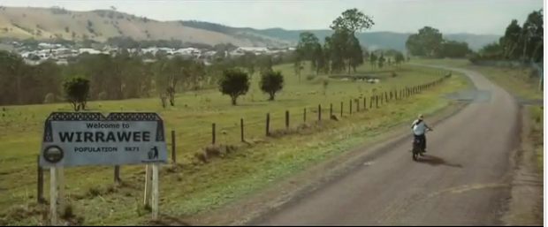
Wirrawee is a small country town which only has a population of 3871 people.

Slide 2
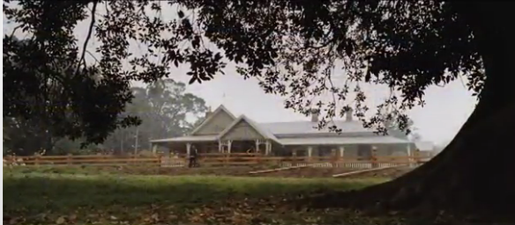
Life is pretty much normal

Slide 3
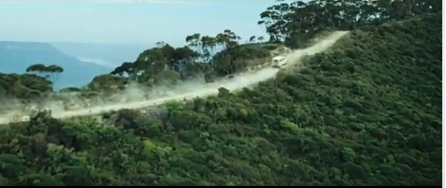
Having a small vacation with a group of friends up to Hell in the Landrover

Slide 4
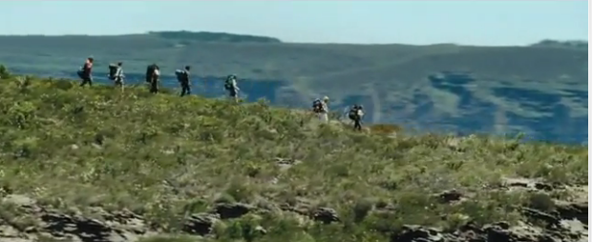
After driving the landrover as far as they could they started to
wake the rest of the walk to Hell

Slide 5
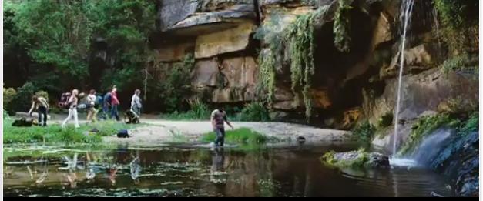
Arriving at Hell

Slide 6
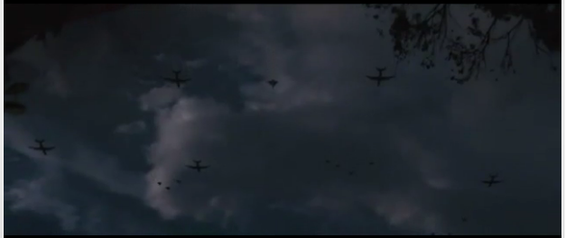
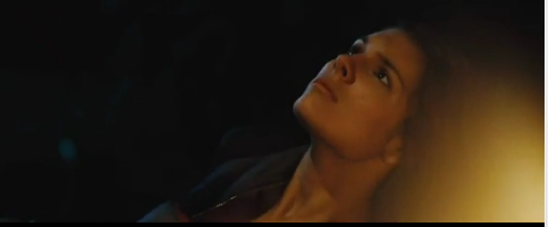
Discovering that plains are flying ahead without lights at night“something is not right”

Slide 7
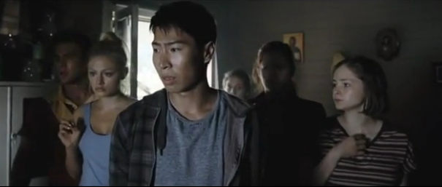
Arriving back at Wirrawee to discover that your dogs are no longer alive and that some thing has happened to your family

Slide 8
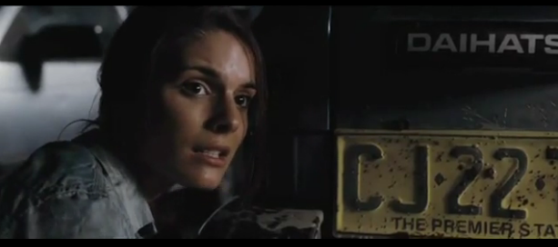
Finding out that you are in a middle of a war ..... and

Slide 9
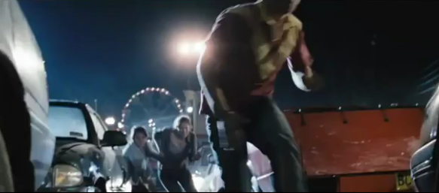
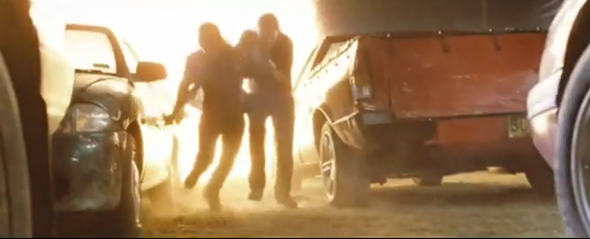
You have to run for your life and survive

Slide 10
How would you cope?

